Slide 1
Functional Blocks
Digital Logic Design

Slide 2
Outline
Decoders
Encoders
Multiplexers
Demultiplexers
Design Examples

Slide 3
Functional Blocks
A functional block is a combinational circuit
We will study blocks, such as decoders and multiplexers
Functional blocks are very common and useful in design
In the past, functional blocks were integrated circuits
SSI: Small Scale Integration = tens of gates
MSI: Medium Scale Integration = hundreds of gates
LSI: Large Scale Integration = thousands of gates
VLSI: Very Large Scale Integration = millions of gates
Today, functional blocks are part of a design library
Tested for correctness and reused in many projects

Slide 4
Binary Decoders
Given a n-bit binary code, there are 2^{n} possible code values
The decoder has an output for each possible code value
The n-to-2^{n} decoder has n inputs and 2^{n} outputs
Depending on the input code, only one output is set to logic 1
The conversion of input to output is called decoding
n to 2^{n}
Decoder
A decoder can have less than 2^{n} outputs if some input codes are unused
n Inputs
2^{n} Outputs
⋅⋅⋅
⋅⋅⋅

Slide 5
Examples of Binary Decoders
Inputs | Outputs
a₁ a₀ | d₀ | d₁ | d₂ | d₃
0 0 | 1 | 0 | 0 | 0
0 1 | 0 | 1 | 0 | 0
1 0 | 0 | 0 | 1 | 0
1 1 | 0 | 0 | 0 | 1
2-to-4
Decoder
d₀
0
a₁
1
1
d₁
Truth
Tables
2 Inputs
4 Outputs
a₀
0
2
d₂
3
d₃
Inputs | Outputs
a₂ a₁ a₀ | d₀ | d₁ | d₂ | d₃ | d₄ | d₅ | d₆ | d₇
0 0 0 | 1 | 0 | 0 | 0 | 0 | 0 | 0 | 0
0 0 1 | 0 | 1 | 0 | 0 | 0 | 0 | 0 | 0
0 1 0 | 0 | 0 | 1 | 0 | 0 | 0 | 0 | 0
0 1 1 | 0 | 0 | 0 | 1 | 0 | 0 | 0 | 0
1 0 0 | 0 | 0 | 0 | 0 | 1 | 0 | 0 | 0
1 0 1 | 0 | 0 | 0 | 0 | 0 | 1 | 0 | 0
1 1 0 | 0 | 0 | 0 | 0 | 0 | 0 | 1 | 0
1 1 1 | 0 | 0 | 0 | 0 | 0 | 0 | 0 | 1
3-to-8
Decoder
d₀
0
1
d₁
2
d₂
a₂
2
3
d₃
3 Inputs
a₁
1
8 Outputs
4
d₄
a₀
0
5
d₅
6
d₆
7
d₇

Slide 6

















Decoder Implementation
Inputs | Outputs
a₁ a₀ | d₀ | d₁ | d₂ | d₃
0 0 | 1 | 0 | 0 | 0
0 1 | 0 | 1 | 0 | 0
1 0 | 0 | 0 | 1 | 0
1 1 | 0 | 0 | 0 | 1
$$a_{2}$$
3-to-8 Decoder
$$a_{1}$$
$$a_{0}$$
$$d_{0}=a_{2}^{′}a_{1}^{′}a_{0}^{′}$$
$$d_{1}=a_{2}^{′}a_{1}^{′}a_{0}$$
2-to-4
Decoder
$$d_{2}=a_{2}^{′}a_{1}^{}a_{0}^{′}$$
$$a_{1}$$
$d_{0}=a_{1}^{′}a_{0}^{′}$
$$d_{3}=a_{2}^{′}a_{1}^{}a_{0}$$
$$a_{0}$$
$$d_{1}=a_{1}^{′}a_{0}$$
$$d_{4}=a_{2}^{}a_{1}^{′}a_{0}^{′}$$
$$d_{2}=a_{1}a_{0}^{′}$$
$$d_{5}=a_{2}^{}a_{1}^{′}a_{0}$$
$$d_{3}=a_{1}a_{0}$$
$$d_{6}=a_{2}^{}a_{1}^{}a_{0}^{′}$$
$$d_{7}=a_{2}^{}a_{1}^{}a_{0}$$
Each decoder output is a minterm

Slide 7
Using Decoders to Implement Functions
A decoder generates all the minterms
A Boolean function can be expressed as a sum of minterms
Any function can be implemented using a decoder + OR gate
Note: the function must not be minimized
Example: Full Adder sum = ∑(1, 2, 4, 7), cout = ∑(3, 5, 6, 7)
Inputs | Outputs
a b c | cout | sum
0 0 0 | 0 | 0
0 0 1 | 0 | 1
0 1 0 | 0 | 1
0 1 1 | 1 | 0
1 0 0 | 0 | 1
1 0 1 | 1 | 0
1 1 0 | 1 | 0
1 1 1 | 1 | 1
3-to-8
Decoder
d₀
d₁
d₂
sum
a
2
d₃
b
1
d₄
c
0
cout
d₅
d₆
d₇

Slide 8
Using Decoders to Implement Functions
Good if many output functions of the same input variables
If number of minterms is large ➔ Wider OR gate is needed
Use NOR gate if number of maxterms is less than minterms
Example: f = ∑(2, 5, 6), g = ∏(3, 6) ➔ g' = ∑(3, 6), h = ∑(0, 5)
Inputs | Outputs
a b c | f | g | h
0 0 0 | 0 | 1 | 1
0 0 1 | 0 | 1 | 0
0 1 0 | 1 | 1 | 0
0 1 1 | 0 | 0 | 0
1 0 0 | 0 | 1 | 0
1 0 1 | 1 | 1 | 1
1 1 0 | 1 | 0 | 0
1 1 1 | 0 | 1 | 0
3-to-8
Decoder
d₀
d₁
f
d₂
a
2
d₃
b
1
g
d₄
c
0
d₅
d₆
h
d₇

Slide 9







2-to-4 Decoder with Enable Input
Truth Table
2-to-4
Decoder
d₀
0
Inputs |  | Outputs
EN | a₁ a₀ | d₀ | d₁ | d₂ | d₃
0 | X X | 0 | 0 | 0 | 0
1 | 0 0 | 1 | 0 | 0 | 0
1 | 0 1 | 0 | 1 | 0 | 0
1 | 1 0 | 0 | 0 | 1 | 0
1 | 1 1 | 0 | 0 | 0 | 1
a₁
1
1
d₁
a₀
0
d₂
2
EN
3
d₃
$$a_{1}$$
$$a_{0}$$
$$d_{0}=EN a_{1}^{′}a_{0}^{′}$$
$$d_{1}=EN a_{1}^{′}a_{0}$$
If EN input is zero then all outputs are zeros, regardless of a₁ and a₀
$$d_{2}=EN a_{1}a_{0}^{′}$$
$$d_{3}=EN a_{1}a_{0}$$
$$EN$$

Slide 10
Building Larger Decoders
Larger decoders can be build using smaller ones
A 3-to-8 decoder can be built using:
Two 2-to-4 decoders with Enable and an inverter (1-to-2 decoder)
Inputs |  | Outputs
a₂ | a₁ a₀ | d₀ | d₁ | d₂ | d₃ | d₄ | d₅ | d₆ | d₇
0 | 0 0 | 1 | 0 | 0 | 0 | 0 | 0 | 0 | 0
0 | 0 1 | 0 | 1 | 0 | 0 | 0 | 0 | 0 | 0
0 | 1 0 | 0 | 0 | 1 | 0 | 0 | 0 | 0 | 0
0 | 1 1 | 0 | 0 | 0 | 1 | 0 | 0 | 0 | 0
1 | 0 0 | 0 | 0 | 0 | 0 | 1 | 0 | 0 | 0
1 | 0 1 | 0 | 0 | 0 | 0 | 0 | 1 | 0 | 0
1 | 1 0 | 0 | 0 | 0 | 0 | 0 | 0 | 1 | 0
1 | 1 1 | 0 | 0 | 0 | 0 | 0 | 0 | 0 | 1
a₂
Top
2-to-4
Decoder
d₀
0
a₁
1
1
d₁
a₀
0
2
d₂
EN
3
d₃
1-to-2 Decoder
Bottom
2-to-4
Decoder
d₄
0
1
1
d₅
0
d₆
2
EN
3
d₇

Slide 11
Building Larger Decoders
2-to-4
Decoder
0
d₀
a₁
1
0
A 4-to-16 decoder with enable can be built using five 2-to-4 decoders with enables
1
d₁
a₀
0
d₂
2
EN
3
d₃
2-to-4
Decoder
1
d₄
1
0
1
d₅
0
d₆
2-to-4
Decoder
2
a₃
1
0
EN
3
d₇
a₂
0
1
2
2-to-4
Decoder
2
d₈
1
0
EN
EN
3
1
d₉
0
d₁₀
2
EN
3
d₁₁
Larger decoders can be built hierarchically in a similar way
2-to-4
Decoder
3
d₁₂
1
0
1
d₁₃
0
d₁₄
2
EN
3
d₁₅

Slide 12
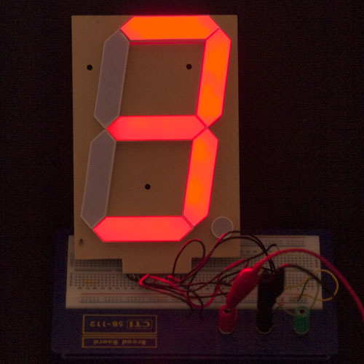
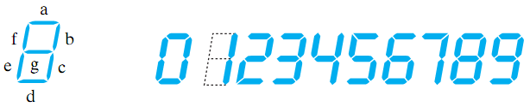
BCD to 7-Segment Decoder
Seven-Segment Display:
Made of Seven segments: light-emitting diodes (LED)
Found in electronic devices: such as clocks, calculators, etc.
BCD to
7-Segment
Decoder
a
I₃
b
I₂
c
BCD to 7-Segment Decoder
Called also a decoder, but not a binary decoder
Accepts as input a BCD decimal digit (0 to 9)
Generates output to the seven LED segments to display the BCD digit
Each segment can be turned on or off separately
d
I₁
e
I₀
f
g

Slide 13
BCD to 7-Segment Decoder
Specification:
Input: 4-bit BCD (I₃, I₂, I₁, I₀)
Output: 7-bit (a, b, c, d, e, f, g)
Display should be OFF for Non-BCD input codes.
Implementation can use:
A binary decoder
Additional gates
Truth Table
BCD input I₃ I₂ I₁ I₀ | 7-Segment Output a b c d e f g
0 0 0 0 | 1 1 1 1 1 1 0
0 0 0 1 | 0 1 1 0 0 0 0
0 0 1 0 | 1 1 0 1 1 0 1
0 0 1 1 | 1 1 1 1 0 0 1
0 1 0 0 | 0 1 1 0 0 1 1
0 1 0 1 | 1 0 1 1 0 1 1
0 1 1 0 | 1 0 1 1 1 1 1
0 1 1 1 | 1 1 1 0 0 0 0
1 0 0 0 | 1 1 1 1 1 1 1
1 0 0 1 | 1 1 1 1 0 1 1
1010 to 1111 | 0 0 0 0 0 0 0

Slide 14

Implementing a BCD to 7-Segment Decoder
Truth Table
a
4-to-10
Binary
Decoder
I₃ I₂ I₁ I₀ | a b c d e f g
0 0 0 0 | 1 1 1 1 1 1 0
0 0 0 1 | 0 1 1 0 0 0 0
0 0 1 0 | 1 1 0 1 1 0 1
0 0 1 1 | 1 1 1 1 0 0 1
0 1 0 0 | 0 1 1 0 0 1 1
0 1 0 1 | 1 0 1 1 0 1 1
0 1 1 0 | 1 0 1 1 1 1 1
0 1 1 1 | 1 1 1 0 0 0 0
1 0 0 0 | 1 1 1 1 1 1 1
1 0 0 1 | 1 1 1 1 0 1 1
1010 – 1111 | 0 0 0 0 0 0 0
0
b
1
2
c
I₃
3
I₂
4
d
I₁
5
I₀
6
e
7
8
9
f
$$I_{3}(I_{2}+I_{1})$$
g
Input > 9
NOR gate is used for 0's

Slide 15







NAND Decoders with Inverted Outputs
Truth Table
2-to-4
Decoder
d₀
0
Inputs |  | Outputs
EN | a₁ a₀ | d₀ | d₁ | d₂ | d₃
1 | X X | 1 | 1 | 1 | 1
0 | 0 0 | 0 | 1 | 1 | 1
0 | 0 1 | 1 | 0 | 1 | 1
0 | 1 0 | 1 | 1 | 0 | 1
0 | 1 1 | 1 | 1 | 1 | 0
a₁
1
1
d₁
a₀
0
d₂
2
EN
3
d₃
$$a_{1}$$
$$a_{0}$$
$$d_{0}=(EN^{′}a_{1}^{′}a_{0}^{′})′$$
$$d_{1}=(EN^{′}a_{1}^{′}a_{0})′$$
Some decoders are constructed with NAND gates. Their outputs are inverted. The Enable input is also active low (Enable if zero)
$$d_{2}=(EN^{′}a_{1}a_{0}^{′})′$$
$$d_{3}=(EN^{′}a_{1}a_{0})′$$
$$EN$$

Slide 16
Using NAND Decoders
NAND decoders can be used to implement functions
Use NAND gates to output the minterms (if fewer ones)
Use AND gates to output the maxterms (if fewer zeros)
Example: f = ∑(2, 5, 6), g = ∏(3, 6), h = ∑(0, 5)
Inputs | Outputs
a b c | f | g | h
0 0 0 | 0 | 1 | 1
0 0 1 | 0 | 1 | 0
0 1 0 | 1 | 1 | 0
0 1 1 | 0 | 0 | 0
1 0 0 | 0 | 1 | 0
1 0 1 | 1 | 1 | 1
1 1 0 | 1 | 0 | 0
1 1 1 | 0 | 1 | 0
3-to-8
Decoder
Inverted
Outputs
(NAND)
d₀
d₁
f
d₂
a
2
d₃
b
1
g
d₄
c
0
d₅
d₆
h
d₇

Slide 17
Encoders
An encoder performs the opposite operation of a decoder
It converts a 2^{n} input to an n-bit output code
The output indicates which input is active (logic 1)
Typically, one input should be 1 and all others must be 0's
The conversion of input to output is called encoding
A encoder can have less than 2^{n} inputs if some input lines are unused
2^{n} to n
Encoder
2^{n} Inputs
n Outputs
⋅⋅⋅
⋅⋅⋅

Slide 18
Example of an 8-to-3 Binary Encoder
8 inputs, 3 outputs, only one input is 1, all others are 0's
Encoder generates the output binary code for the active input
Output is not specified if more than one input is 1
Inputs |  |  |  |  |  |  |  | Outputs
d₇ | d₆ | d₅ | d₄ | d₃ | d₂ | d₁ | d₀ | a₂ | a₁ | a₀
0 | 0 | 0 | 0 | 0 | 0 | 0 | 1 | 0 | 0 | 0
0 | 0 | 0 | 0 | 0 | 0 | 1 | 0 | 0 | 0 | 1
0 | 0 | 0 | 0 | 0 | 1 | 0 | 0 | 0 | 1 | 0
0 | 0 | 0 | 0 | 1 | 0 | 0 | 0 | 0 | 1 | 1
0 | 0 | 0 | 1 | 0 | 0 | 0 | 0 | 1 | 0 | 0
0 | 0 | 1 | 0 | 0 | 0 | 0 | 0 | 1 | 0 | 1
0 | 1 | 0 | 0 | 0 | 0 | 0 | 0 | 1 | 1 | 0
1 | 0 | 0 | 0 | 0 | 0 | 0 | 0 | 1 | 1 | 1
d₀
8-to-3
Binary
Encoder
0
d₁
1
d₂
2
2
a₂
d₃
3
a₁
8 Inputs
1
3 Outputs
d₄
4
0
a₀
d₅
5
d₆
6
d₇
7

Slide 19
8-to-3 Binary Encoder Implementation
Inputs |  |  |  |  |  |  |  | Outputs
d₇ | d₆ | d₅ | d₄ | d₃ | d₂ | d₁ | d₀ | a₂ | a₁ | a₀
0 | 0 | 0 | 0 | 0 | 0 | 0 | 1 | 0 | 0 | 0
0 | 0 | 0 | 0 | 0 | 0 | 1 | 0 | 0 | 0 | 1
0 | 0 | 0 | 0 | 0 | 1 | 0 | 0 | 0 | 1 | 0
0 | 0 | 0 | 0 | 1 | 0 | 0 | 0 | 0 | 1 | 1
0 | 0 | 0 | 1 | 0 | 0 | 0 | 0 | 1 | 0 | 0
0 | 0 | 1 | 0 | 0 | 0 | 0 | 0 | 1 | 0 | 1
0 | 1 | 0 | 0 | 0 | 0 | 0 | 0 | 1 | 1 | 0
1 | 0 | 0 | 0 | 0 | 0 | 0 | 0 | 1 | 1 | 1
8-to-3
Binary
Encoder
d₀
0
d₁
1
d₂
2
2
a₂
d₃
3
1
a₁
d₄
4
0
a₀
d₅
5
d₆
6
d₇
7
d₄
d₅
d₆
d₇
a₂
a₂ = d₄ + d₅ + d₆ + d₇
8-to-3 binary encoder implemented using three
4-input OR gates
d₂
d₃
d₆
d₇
a₁
a₁ = d₂ + d₃ + d₆ + d₇
d₁
d₃
d₅
d₇
a₀ = d₁ + d₃ + d₅ + d₇
a₀

Slide 20
Binary Encoder Limitations
Exactly one input must be 1 at a time (all others must be 0's)
If more than one input is 1 then the output will be incorrect
For example, if d₃ = d₆ = 1
Then a₂ a₁ a₀ = 111 (incorrect)
Two problems to resolve:
If two inputs are 1 at the same time, what should be the output?
If all inputs are 0's, what should be the output?
Output a₂ a₁ a₀ = 000 if d₀ = 1 or all inputs are 0's
How to resolve this ambiguity?
a₂ = d₄ + d₅ + d₆ + d₇
a₁ = d₂ + d₃ + d₆ + d₇
a₀ = d₁ + d₃ + d₅ + d₇

Slide 21
Priority Encoder
Eliminates the two problems of the binary encoder
Inputs are ranked from highest priority to lowest priority
If more than one input is active (logic 1) then priority is used
Output encodes the active input with higher priority
If all inputs are zeros then the V (Valid) output is zero
Indicates that all inputs are zeros
Inputs |  |  |  | Outputs
d₃ | d₂ | d₁ | d₀ | a₁ | a₀ | V
0 | 0 | 0 | 0 | X | X | 0
0 | 0 | 0 | 1 | 0 | 0 | 1
0 | 0 | 1 | X | 0 | 1 | 1
0 | 1 | X | X | 1 | 0 | 1
1 | X | X | X | 1 | 1 | 1
d₃
4-to-2 Priority
Encoder
Condensed
Truth Table
All 16 cases
are listed
3 = highest priority
1
a₁
d₂
2
0
a₀
d₁
1
d₀
0 = lowest priority
V

Slide 22
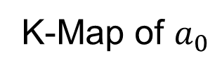




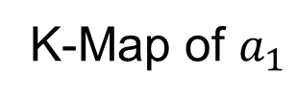

Implementing a 4-to-2 Priority Encoder
K-Map of $a_{1}$
K-Map of $a_{0}$
Inputs |  |  |  | Outputs
d₃ | d₂ | d₁ | d₀ | a₁ | a₀ | V
0 | 0 | 0 | 0 | X | X | 0
0 | 0 | 0 | 1 | 0 | 0 | 1
0 | 0 | 1 | X | 0 | 1 | 1
0 | 1 | X | X | 1 | 0 | 1
1 | X | X | X | 1 | 1 | 1
$$d_{1}d_{0}$$
$$d_{1}d_{0}$$
$$d_{3}d_{2}$$
00
01
11
10
$$d_{3}d_{2}$$
00
01
11
10
00
X
00
X
1
1
01
1
1
1
1
01
11
1
1
1
1
11
1
1
1
1
10
1
1
1
1
10
1
1
1
1
d₃
a₁
Output Expressions:
$a_{1}=d_{3}+d_{2}$
$a_{0}=d_{3}+d_{1} d_{2}^{′}$
$V=d_{3}+d_{2}+d_{1}+d_{0}$
d₂
a₀
d₁
V
d₀

Slide 23
Multiplexers
Selecting data is an essential function in digital systems
Functional blocks that perform selecting are called multiplexers
A Multiplexer (or Mux) is a combinational circuit that has:
Multiple data inputs (typically 2^{n}) to select from
An n-bit select input S used for control
One output Y
The n-bit select input directs one of the data inputs to the output
d₀
d₁
d₂
Mux
2^{n} Inputs
.
.
.
Y
d_{2n–1}
n
S

Slide 24
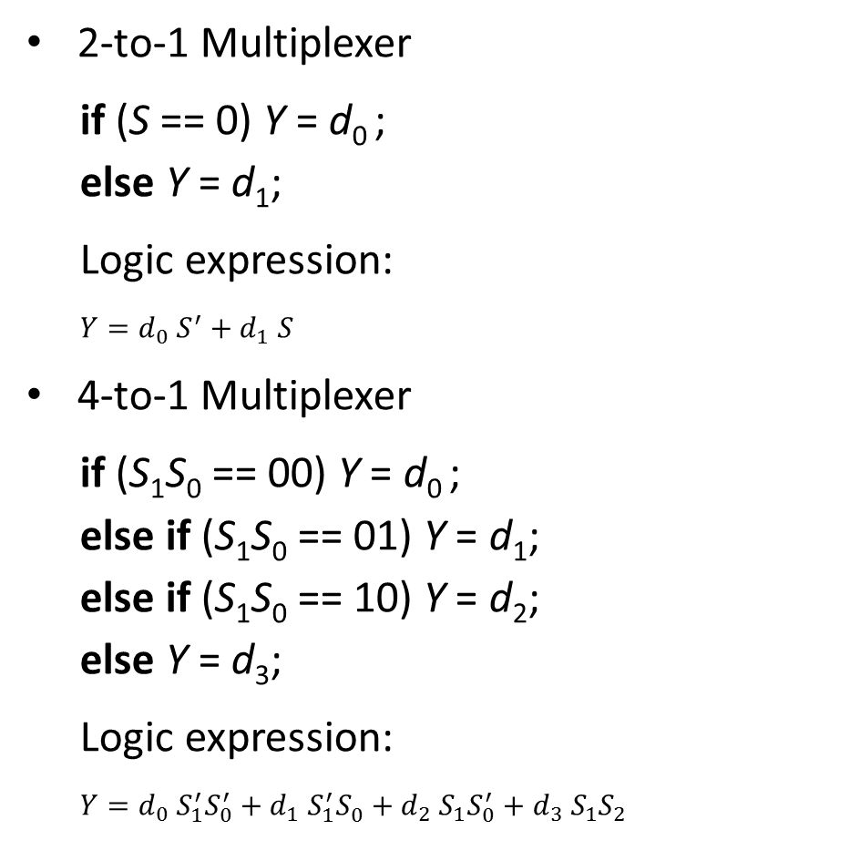

Examples of Multiplexers
2-to-1 Multiplexer
if (S == 0) Y = d₀ ;
else Y = d₁;
Logic expression:
$Y=d_{0} S^{′}+d_{1} S$
4-to-1 Multiplexer
if (S₁S₀ == 00) Y = d₀ ;
else if (S₁S₀ == 01) Y = d₁;
else if (S₁S₀ == 10) Y = d₂;
else Y = d₃;
Logic expression:
$Y=d_{0} S_{1}^{′}S_{0}^{′}+d_{1} S_{1}^{′}S_{0}^{}+d_{2} S_{1}S_{0}^{′}+d_{3} S_{1}S_{2}$
Inputs |  |  | Output
S | d₀ | d₁ | Y
0 | 0 | X | 0 = d₀
0 | 1 | X | 1 = d₀
1 | X | 0 | 0 = d₁
1 | X | 1 | 1 = d₁
d₀
0
Mux
Y
d₁
1
S
d₀
0
Inputs |  |  |  |  |  | Output
S₁ | S₀ | d₀ | d₁ | d₂ | d₃ | Y
0 | 0 | 0 | X | X | X | 0 = d₀
0 | 0 | 1 | X | X | X | 1 = d₀
0 | 1 | X | 0 | X | X | 0 = d₁
0 | 1 | X | 1 | X | X | 1 = d₁
1 | 0 | X | X | 0 | X | 0 = d₂
1 | 0 | X | X | 1 | X | 1 = d₂
1 | 1 | X | X | X | 0 | 0 = d₃
1 | 1 | X | X | X | 1 | 1 = d₃
d₁
Mux
1
d₂
$$Y$$
2
d₃
3
1 0
S₁S₀

Slide 25
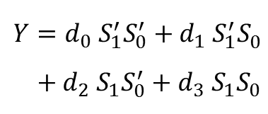

Implementing Multiplexers
d₀
Enabling
AND Gates
d₀
0
Mux
$Y=d_{0} S^{′}+$ $d_{1} S$
Y
d₁
d₁
1
S
S
d₀
Enabling
AND Gates
d₀
0
d₁
d₁
Mux
1
$Y=d_{0} S_{1}^{′}S_{0}^{′}+d_{1} S_{1}^{′}S_{0}^{}$
$+ d_{2} S_{1}S_{0}^{′}+d_{3} S_{1}S_{0}$
d₂
d₂
Y
2
d₃
3
1 0
d₃
S₁S₀
S₁
S₀

Slide 26
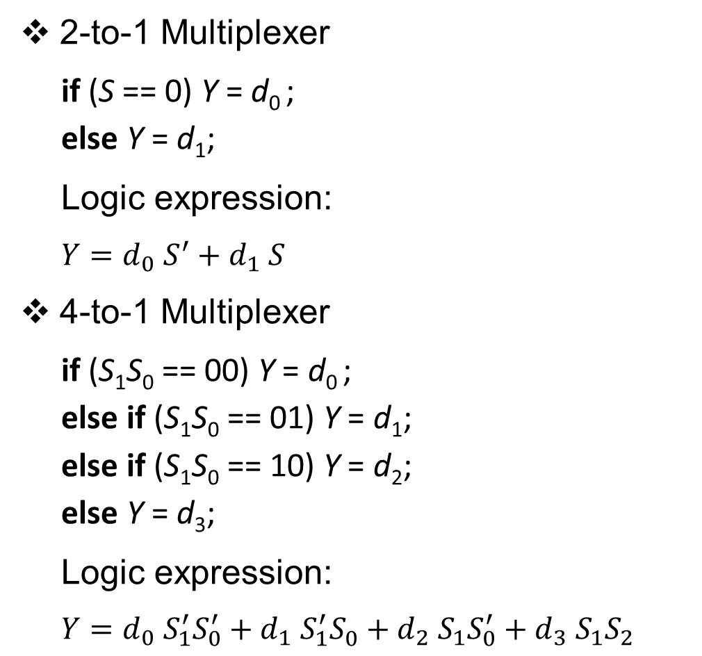
3-State Gate
Logic gates studied so far have two outputs: 0 and 1
Three-State gate has three possible outputs: 0, 1, Z
Z is the Hi-Impedance output
Z means that the output is disconnected from the input
Gate behaves as an open switch between input and output
Input c connects input to output
c is the control (enable) input
If c is 0 then f = Z
If c is 1 then f = input x
c | x | f
0 | 0 | Z
0 | 1 | Z
1 | 0 | 0
1 | 1 | 1
$$c$$
$$x$$
$$f$$
3-state gate

Slide 27

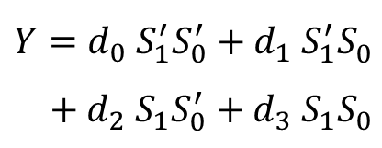






Variations of the 3-State Gate
Control input c and output f can be inverted
A bubble is inserted at the input c or output f
$$c$$
$$c$$
$$c$$
$$x$$
$$f$$
$$x$$
$$f$$
$$x$$
$$f$$
inverted c
inverted f
inverted c, f
c | x | f
0 | 0 | 0
0 | 1 | 1
1 | 0 | Z
1 | 1 | Z
c | x | f
0 | 0 | Z
0 | 1 | Z
1 | 0 | 1
1 | 1 | 0
c | x | f
0 | 0 | 1
0 | 1 | 0
1 | 0 | Z
1 | 1 | Z

Slide 28












Wired Output
Logic gates with 0 and 1 outputs cannot have their outputs wired together
$$a$$
This will result in a short circuit that will burn the gates
$$b$$
$$f$$
$$c$$
$$d$$
$$c1$$
c1 | c2 | c3 | f
0 | 0 | 0 | Z
1 | 0 | 0 | x1
0 | 1 | 0 | x2
0 | 0 | 1 | x3
0 | 1 | 1 | Burn
1 | 0 | 1 | Burn
1 | 1 | 0 | Burn
1 | 1 | 1 | Burn
3-state gates can wire their outputs together
$$x1$$
$$c2$$
At most one 3-state gate can be enabled at a time
Otherwise, conflicting outputs will burn the circuit
$$x2$$
$$f$$
$$c3$$
$$x3$$

Slide 29

Implementing Multiplexers with 3-State Gates
A Multiplexer can also be implemented using:
A decoder
Three-state gates
d₀
0
d₁
Mux
1
d₂
$$Y$$
2
3-State Gates
d₃
3
1 0
d₀
S₁S₀
d₁
3-State Gates
Y
d₀
0
d₀
d₂
Mux
Y
Y
d₁
1
d₁
d₃
1-to-2
Decoder
0
1
2
3
S
S
S₁
2-to-4
Decoder
1
S₀
0

Slide 30
Building Larger Multiplexers
Larger multiplexers can be built hierarchically using smaller ones
d₀
d₀
8-to-1 Mux
0
0
d₀
0
d₁
Mux
d₁
1
Mux
1
d₁
1
d₂
2
d₂
2
0
d₃
3
1 0
d₃
3
Y
S₀
Mux
Y
0
d₄
4
1
Mux
Y
d₂
0
S₁S₀
d₅
5
Mux
S₁
1
d₃
1
d₄
d₆
6
0
2 1 0
d₅
S₂
d₇
7
Mux
S₀
1
d₆
2
S₂S₁S₀
d₇
3
1 0
Building 4-to-1
Mux using three
2-to-1 Muxes
Building 8-to-1 Mux
using two 4-to-1 Muxes
and a 2-to-1 Mux
S₁S₀

Slide 31
Multiplexers with Vector Input and Output
The inputs and output of a multiplexer can be m-bit vectors
A [m–1:0]
0
A [m–1:0]
0
m
m
Mux
B [m–1:0]
Mux
Y [m–1: 0]
1
Y [m–1: 0]
C [m–1:0]
m
B [m–1:0]
m
2
m
1
D [m–1:0]
m
1 0
m
3
m
S
S₁S₀
2-to-1 Multiplexer with m bits
Inputs and output are m-bit vectors
Using m copies of a 2-to-1 Mux
4-to-1 Multiplexer with m bits
Inputs and output are m-bit vectors
Using m copies of a 4-to-1 Mux

Slide 32
Implementing a Function with a Multiplexer
A Multiplexer can be used to implement any logic function
The function must be expressed using its minterms
Example: Implement F(a, b, c) = ∑(1, 2, 6, 7) using a Mux
Solution:
Inputs |  |  | Output
a | b | c | F
0 | 0 | 0 | 0
0 | 0 | 1 | 1
0 | 1 | 0 | 1
0 | 1 | 1 | 0
1 | 0 | 0 | 0
1 | 0 | 1 | 0
1 | 1 | 0 | 1
1 | 1 | 1 | 1
8-to-1 Mux
0
0
The inputs are
used as select
lines to a Mux.
An 8-to-1
Mux is used
because there
are 3 variables
1
1
1
2
0
3
F
0
4
0
5
1
6
1
7
1
0
2
S₂ S₁ S₀ =
a b c

Slide 33
Better Solution with a Smaller Multiplexer
Re-implement F(a, b, c) = ∑(1, 2, 6, 7) using a 4-to-1 Mux
We will use the two select lines for variables a and b
Variable c and its complement are used as inputs to the Mux
Inputs |  |  | Output | Comment
a | b | c | F | F
0 | 0 | 0 | 0 | F = c
0 | 0 | 1 | 1
0 | 1 | 0 | 1 | F = c'
0 | 1 | 1 | 0
1 | 0 | 0 | 0 | F = 0
1 | 0 | 1 | 0
1 | 1 | 0 | 1 | F = 1
1 | 1 | 1 | 1
c
0
c'
1
4-to-1 Mux
F
0
2
1
3
1
0
S₁ S₀ = a b

Slide 34
Implementing Functions: Example 2
Implement F(a, b, c, d) = ∑(1,3,4,11,12,13,14,15) using 8-to-1 Mux
Inputs |  |  |  | Output | Comment
a | b | c | d | F | F
0 | 0 | 0 | 0 | 0 | F = d
0 | 0 | 0 | 1 | 1
0 | 0 | 1 | 0 | 0 | F = d
0 | 0 | 1 | 1 | 1
0 | 1 | 0 | 0 | 1 | F = d'
0 | 1 | 0 | 1 | 0
0 | 1 | 1 | 0 | 0 | F = 0
0 | 1 | 1 | 1 | 0
1 | 0 | 0 | 0 | 0 | F = 0
1 | 0 | 0 | 1 | 0
1 | 0 | 1 | 0 | 0 | F = d
1 | 0 | 1 | 1 | 1
1 | 1 | 0 | 0 | 1 | F = 1
1 | 1 | 0 | 1 | 1
1 | 1 | 1 | 0 | 1 | F = 1
1 | 1 | 1 | 1 | 1
8-to-1 Mux
d
0
1
2
0
3
F
4
5
1
6
7
0
2
1
S₂ S₁ S₀ =
a b c

Slide 35
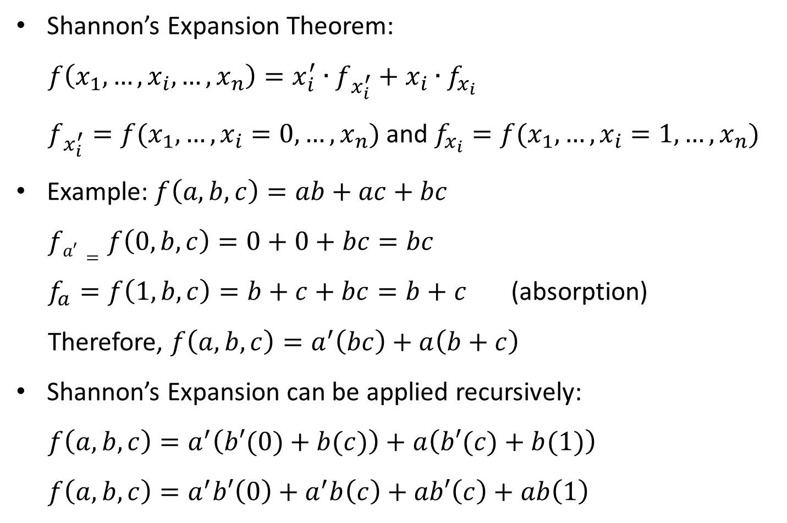
Shannon’s Expansion
Shannon’s Expansion Theorem:
$f\left(x_{1},…, x_{i}, …, x_{n}\right)=x_{i}^{′}∙f_{x_{i}^{′}}+x_{i}∙f_{x_{i}}$
$f_{x_{i}^{′}}=f(x_{1},…, x_{i}=0, …, x_{n})$ and $f_{x_{i}}=f(x_{1},…, x_{i}=1, …, x_{n})$
Example: $f\left(a, b, c\right)=ab+ac+bc$
$fa′=f\left(0,b,c\right)=0+0+bc=bc$
$f_{a}=f\left(1, b,c\right)=b+c+bc=b+c$ (absorption)
Therefore, $f\left(a,b,c\right)=a^{′}\left(bc\right)+a\left(b+c\right)$
Shannon’s Expansion can be applied recursively:
$f\left(a,b,c\right)=a^{′}\left(b′(0)+b(c)\right)+a\left(b′(c)+b(1)\right)$
$f\left(a,b,c\right)=a^{′}b′\left(0\right)+a^{′}b\left(c\right)+ab′\left(c\right)+ab\left(1\right)$

Slide 36
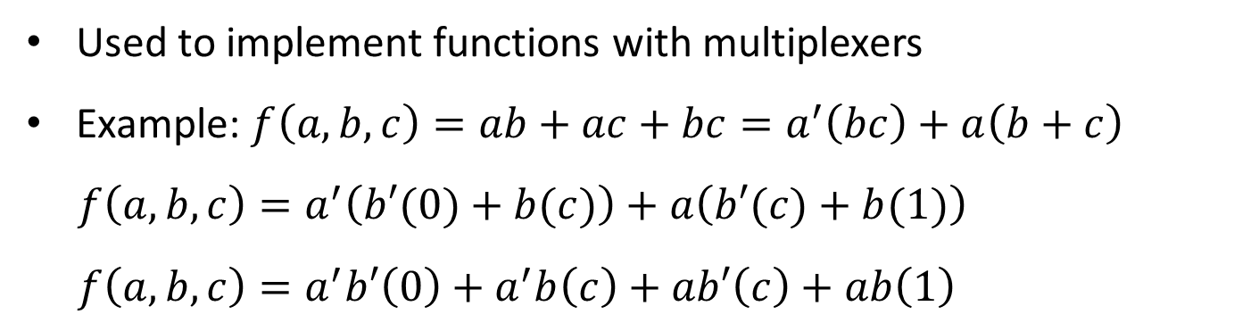
Shannon’s Expansion (cont’d)
Used to implement functions with multiplexers
Example: $f\left(a, b, c\right)=ab+ac+bc=a^{′}\left(bc\right)+a\left(b+c\right)$
$f\left(a,b,c\right)=a^{′}\left(b′(0)+b(c)\right)+a\left(b′(c)+b(1)\right)$
$f\left(a,b,c\right)=a^{′}b′\left(0\right)+a^{′}b\left(c\right)+ab′\left(c\right)+ab\left(1\right)$
4×1 mux
0
0
0
0
Mux
c
1
c
1
4-to-1 Mux
Three
2×1 muxes
0
f
b
Mux
f
1
c
2
c
0
Mux
a
1
3
1
1
0
1
b
S₁ S₀ = a b

Slide 37
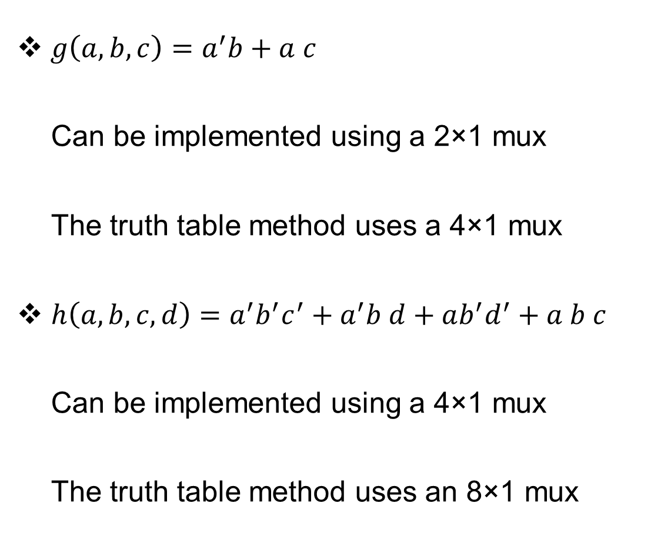
Shannon’s Expansion (cont’d)
$g\left(a, b, c\right)=a^{′}b+a c$
Can be implemented using a 2×1 mux
The truth table method uses a 4×1 mux
$h\left(a,b,c,d\right)=a^{′}b^{′}c^{′}+a^{′}b d+ab^{′}d^{′}+a b c$
Can be implemented using a 4×1 mux
The truth table method uses an 8×1 mux
b
0
Mux
g
c
1
a
c’
0
d
1
4-to-1 Mux
h
d’
2
c
3
1
0
S₁ S₀ = a b

Slide 38
Demultiplexer
Performs the inverse operation of a Multiplexer
A Demultiplexer (or Demux) is a combinational circuit that has:
One data input I
An n-bit select input S
A maximum of 2^{n} data outputs
The Demux directs the data input to one of the outputs
According to the select input S
Demux
d₀
d₁
I
d₂
2^{n} Outputs
.
.
.
d_{2n–1}
n
S

Slide 39
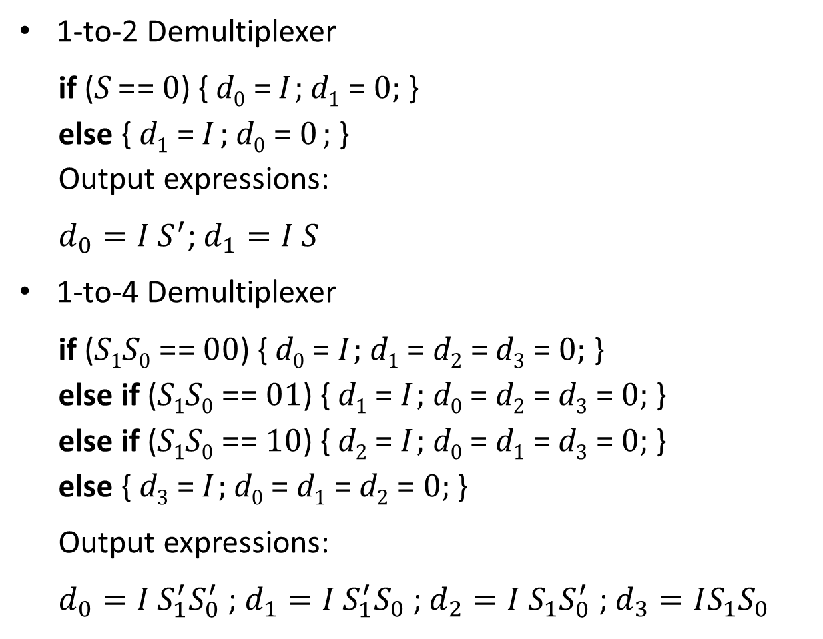
Examples of Demultiplexers
1-to-2 Demultiplexer
if (S == 0) { d₀ = I ; d₁ = 0; }
else { d₁ = I ; d₀ = 0 ; }
Output expressions:
$d_{0}=I S^{′}$; $d_{1}=I S$
1-to-4 Demultiplexer
if (S₁S₀ == 00) { d₀ = I ; d₁ = d₂ = d₃ = 0; }
else if (S₁S₀ == 01) { d₁ = I ; d₀ = d₂ = d₃ = 0; }
else if (S₁S₀ == 10) { d₂ = I ; d₀ = d₁ = d₃ = 0; }
else { d₃ = I ; d₀ = d₁ = d₂ = 0; }
Output expressions:
$d_{0}=I S_{1}^{′}S_{0}^{′}$ ; $d_{1}=I S_{1}^{′}S_{0}$ ; $d_{2}=I S_{1}S_{0}^{′}$ ; $d_{3}=IS_{1}S_{0}$
Demux
0
d₀
I
2 Outputs
1
d₁
S
Demux
d₀
0
1
d₁
I
4 Outputs
2
d₂
1
0
3
d₃
S₁S₀

Slide 40
Demultiplexer = Decoder with Enable
A 1-to-4 demux is equivalent to a 2-to-4 decoder with enable
Demux select input S₁ is equivalent to Decoder input a₁
Demux select input S₀ is equivalent to Decoder input a₀
Demux Input I is equivalent to Decoder Enable EN
2-to-4
Decoder
d₀
Demux
0
0
d₀
S₁ = a₁
1
1
d₁
d₁
S₀ = a₀
0
d₂
I
1
4 Outputs
2
2
d₂
I = EN
3
d₃
1
0
3
d₃
Think of a decoder as directing the Enable signal to one output
S₁S₀
In general, a demux with n select inputs and 2^{n} outputs is equivalent to a n-to-2^{n} decoder with enable input

Slide 41
2-by-2 Crossbar Switch
A 2×2 crossbar switch is a combinational circuit that has:
Two m-bit Inputs: A and B
Two m-bit outputs: X and Y
1-bit select input S
Implement the 2×2 crossbar switch using multiplexers
Solution: Two 2-input multiplexers are used
if (S == 0) { X = A; Y = B; }
else { X = B; Y = A; }
m
m
A[m–1:0]
0
m
A[m-1:0]
2×2
Crossbar
Switch
X [m-1:0]
m
Mux
X [m-1:0]
B[m–1:0]
1
m
m
m
S
B[m-1:0]
Y [m-1:0]
0
m
Mux
Y [m-1:0]
S
1

Slide 42
Sorting Two Unsigned Integers
Design a circuit that sorts two m-bit unsigned integers A and B
Inputs: Two m-bit unsigned integers A and B
Outputs: X = min(A, B) and Y = max(A, B)
Solution:
We will use a magnitude comparator to compare A with B, and
2×2 crossbar switch implemented using two 2-input multiplexers
B[m–1:0]
0
m
m-bit
Magnitude Comparator
m
Mux
X [m-1:0] = min(A, B)
A[m–1:0]
A < B
A[m–1:0]
1
m
m
A = B
S
B[m–1:0]
m
0
m
A > B
Mux
Y [m-1:0] = max(A, B)
1

Slide 43
Arithmetic and Logic Unit (ALU)
Can perform many functions
Most common ALU functions
Arithmetic functions: ADD, SUB (Subtract)
Logic functions: AND, OR, XOR, etc.
We will design an ALU with 8 functions
The function F is coded with 3 bits as follows:
ALU Symbol
A[n-1:0]
B[n-1:0]
n
n
F[2:0]
ALU
3
n
V C
R [n-1:0]
Function | ALU Result | Function | ALU Result
F = 000 (ADD) | R = A + B | F = 100 (AND) | R = A & B
F = 001 (ADD + 1) | R = A + B + 1 | F = 101 (OR) | R = A | B
F = 010 (SUB – 1) | R = A – B – 1 | F = 110 (NOR) | R = ~(A | B)
F = 011 (SUB) | R = A – B | F = 111 (XOR) | R = (A ^ B)

Slide 44






Designing a Simple ALU
A[n-1:0]
B[n-1:0]
F[2:0] = 3-bit Function code
n
$$F_{1}$$
n
n
n
n
n
n
n XOR
gates
n AND
gates
n OR
gates
n XOR
gates
n
n
n-bit Adder
c_{n-1}
c₀
$$F_{0}$$
n
n
n
n
c_{n}
0
1
2
3
mux
1
$${S_{1}=F}_{1}$$
n
0
$${S_{0}=F}_{0}$$
0
1
V = Overflow
C = Carry output
mux
$$F_{2}$$
$$S$$
V
C
n
Result = R[n-1:0]

